Slide 1
DEVOPS
Karthik M
Notes:
Boto3 - https://linuxacademy.com/howtoguides/posts/show/topic/14209-automating-aws-with-python-and-boto3
AWS report - https://grafana.com/
New email -karthikm.devops1989@gmail.com
Why are you looking for a change:
---------------------------------------
To get exposure on different tool, and for technical growth in terms of automation/scripting languages.
Word to pdf converter online:
https://smallpdf.com/
Dvd vediosoft – screen recorder

Slide 2
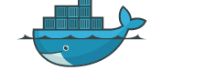
Docker –
The Container Virtualization tool
Notes:
Docker commands refer - https://docs.docker.com/engine/reference/run/#detached--d
Dockerhub – https://hub.docker.com/
Userid – karthikdatabytes
Pass – 98**38s

Slide 3
Agenda
Day 1
Introduction to Docker
Difference between Physical and Virtual server
Virtual Machine and Container Architecture
Docker supported platforms
Installations and verify the Docker.
Day 2
Managing Docker Containers.
Docker run command and understanding the entire command to create a container.
Inspecting Containers and Various Commands.
List running containers only
Show the last container which you have created(stopped/running)
List all containers(stopped and running)
Naming the container
Rename a container
Deleting a container
Delete all containers at once.
Starting a stopped container
Shortcut Keys - to work with Container
Attaching to a running container
Inspecting the container's processes
Stoping a container from 'host machine'
Show last 4 containers (stopped/running)
Find More About The Container
Create demonized container
Remove all running containers
Remove all running/stopped containers

Slide 4
Continued..
Day3
Deep Dive into Docker Images.
Listing Docker images
SETTING-UP NGINX SERVER ON UBUNTU MANUALLY: Project
Images types
Creating docker image using "docker build" command
Writing Dockerfile.
Building docker image
Listing docker image
Testing Image
Data Volumes - Advanced Topic

Slide 5
Continued..
Day 4:
Exec - command
Docker useful commands
Build image without using existing image/image layers
To copy a file to docker container from host machine
Docker logs
Docker Hub and real-time Project.
Working with docker-hub images
Deleting all Images
Deleting an Image
Pushing custom images to docker repository
Searching docker images in docker hub
Pulling the images
Docker Benifits
Real time project

Slide 6
Day 1 –

Slide 7
Docker - Introduction
Docker, Inc. started its life as a platform as a service(PaaS) provider called as dotCloud.
Behind the scenes, the dotCloud platform leveraged Linux containers. To help them create and manage these containers, they built internal tool that they nick-named “Docker”.
That’s how Docker born.
In 2013 they have rebranded the company as “Docker-Inc.”
Docker is used in QA /Dev/PROD. Facebook/Google runs everything on Containers.
Google has nice experience and they developed Kubernetes cluster of services, that work together and manage.

Slide 8
Docker - Overview
Difference between physical server and Virtual server and Docker container.
What is Docker ?
Architecture – CPU/RAM/HD – LINUX OS – DOCKER – CONTAINER
Physical machines – need to have the wiring to be given to work, VM – no wiring needed., Docker – light weight VM
One VM – can have 10 containers
Docker Importance:
Containers are next level of Virtualization.
Container does not need OS, Containers are lightweight.
Containers has applications directly on the binaries and libraries and networking.
Docker engine manages our containers.
As containers are lightweight, we can easily ship them, by having all the prerequisite software's and installed in it, to the registry called as Docker-Hub/Nexus/Artifactory. Then we can pull that and can easily run it.
Why Docker ?
Large application -> micro services(cart db, order db, product db, application db) – to have all these we need 5 VM – wastage of resources
To reproduce the issue, we create a image and fix the issue.
Notes:
What is docker –
Architecture – CPU/RAM/HD – LINUX OS – DOCKER – CONTAINER
Physical machines – need to have the wiring to be given to work, VM – no wiring needed., Docker – light weight VM
One VM – can have 10 containers
Difference – no pre allocation of resources(ram and HD), it takes based on the requirements of the application, zero run time(spin up/start is fast), can create a container without OS, lightweight-same kernel will be distributed from host machine(utilities (grep/ls)/ tools), takes very less time to start and stop and container. Containers are called as guest machines.
Why docker:--------------
Large application -> micro services(cart db order db,product db, application db) – to have all these we need 5 VM – wastage of resources
To reproduce the issue, we create a image and fix the issue.
Supported Platforms --------------------
How docker supports on windows to create the linux machine/
Docker in windows installations comes with a tiny vm-linux kernel
Flavours of linux
Kernel is same – Linux systems –Centos, Ubuntu, RHEL, Solaris, Fedora – flavors of Linux- programs, utilities and GUI gets changed.
Docker is for test regions(QA /Dev) and not for PROD, because of security issues. Facebook/google uses docker

Slide 9
Continued..
Flavours of linux
Kernel is same – Linux systems –Centos, Ubuntu, RHEL, Solaris, Fedora – flavors of Linux- programs, utilities and GUI gets changed.
Docker Supported Platforms- - Docker is supported on - Linux platforms Ubuntu, RHEL, CentOs..etc. - Windows pro /edu - OS X - Windows and OS X: - Windows Docker installer contains a tiny Linux virtual machine. Docker creates container on top of this tiny Linux VM.
- Cloud Platforms Amazon EC2 Google compute Engine..etc.

Slide 10
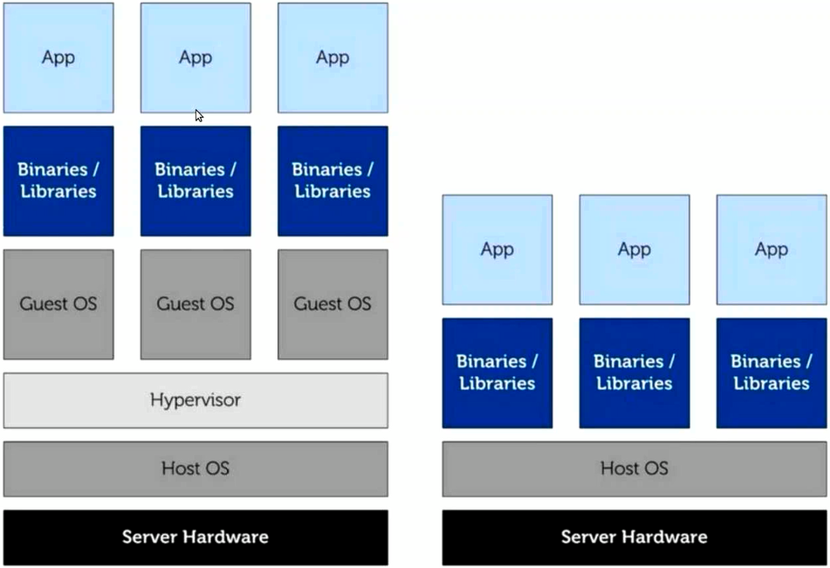
Container Architecture
Virtualization
Containers

Slide 11
Requirements and Installations
Requirements: - 64-bit architecture - Linux 3.8 or later Kernel versions
Installation Steps: ===================== 1. Setup Stable repository: $sudo add-apt-repository "deb [arch=amd64] http s://download.docker.com/linux/ubuntu $(lsb_release -cs) stable" 2. Update apt package index: $ sudo apt-get update 3. Install Latest version of Docker $ sudo apt-get install docker-ce
CE - Community edition – for developers and for trying docker.
EE – Enterprise Edition – for Business # Installation Check sudo docker --version # uninstall docker: $ sudo apt-get remove docker-ce
Notes:
Ubuntu 18.04 installations - https://www.digitalocean.com/community/tutorials/how-to-install-and-use-docker-on-ubuntu-18-04#step-6-%E2%80%94-managing-docker-containers
Docker installations-
----------------------
Follow the steps: -https://docs.docker.com/install/linux/docker-ce/ubuntu/#set-up-the-repository
- If in case error stating that add-apt-repository is not found –execute - $apt-get install software-properties-common

Slide 12
Day 2

Slide 13
Day 2 - Agenda
Managing Docker Containers.
Docker run command and understanding the entire command to create a container.
Inspecting Containers and Various Commands.
List running containers only
Show the last container which you have created(stopped/running)
List all containers(stopped and running)
Naming the container
Rename a container
Deleting a container
Delete all containers at once.
Starting a stopped container
Shortcut Keys - to work with Container
Attaching to a running container
Inspecting the container's processes
Stoping a container from 'host machine'
Show last 4 containers (stopped/running)
Find More About The Container
Create demonized container
Remove all running containers
Remove all running/stopped containers

Slide 14
Managing Docker containers
$sudo docker info
- shows -list of containers, list of images, storage drivers, kernel..etc.
Docker run command:
- "docker run" command provides all launching capabilities for docker to create a container.
- we use `docker run` to create new containers.
# Creating first container
$ sudo docker run -i -t ubuntu /bin/bash
-i : opens STDIN from the container
-t : tells docker to assign a pseudo-tty(emulates a real text terminal device) to the container. --rm : removes the container automatically after it exits.
-p 5000:80 exposes port 5000 externally(host machine) and map it to 80(docker container).
-it : provides interactive shell
-m : is for memory bytes.
-c : for number of CPU’s.
-v : for volume creations(to share the volume across the containers).
-u : to specify the user, this will override the user mentioned in the dockerfile.
-w : working directory – where the commands to be executed.
`ubuntu`: is an image and also called as "stock image" or "base image".
Ubuntu:latest – latest version will be downloaded, Ubuntu:16.04 – specified version will be downloaded. 16.4 – is called as tag.
/bin/bash: which shell need to be installed in the terminal
Notes:
Docker run –help -. For help

Slide 15
Inspect the new container
1. hostname
2. cat /etc/hosts
3. apt-get update
4. apt-get install net-tools
5. ifconfig
observe etho and lo network interfaces with
ip address
6. ps –ef
7. "exit" to stop the container.

Slide 16
Continue
List running containers only
$ docker ps
ps command output
- image
- ID - container can be identified using (short UUID, longer UUID, name)
- $ docker ps -a --no-trunc -q"
Show the last container which you have created(stopped/running)
$ sudo docker ps -l
List all containers(stopped and running)
$ sudo docker ps -a
Naming the container
$ docker run --name Databytes -i -t ubuntu /bin/bash
Note: Two containers can't have the same name.
Rename a container
$ docker rename db-server3 db-server-name3
Deleting a container
$ docker rm ID/name
Delete all containers at once.
$ docker rm `docker ps -a -q`
Notes:
Docker ps – a –q
a is all the info of container
q – quite output – only container id
Echo date – assumes as a string – o/p – date
Echo `date` - backtick will pass the output of the command to the echo .

Slide 17
Continue
Starting a stopped container
sudo docker start gamut
sudo docker stop aa3f365f0fdocker4e
sudo docker restart gamut
Shortcut Keys
Ctrl + p + q - push a running container in background mode.
Ctrl + d - short cut to exit from the container.
Attaching to a running container
docker attach gamut
docker attach b1b1c8dc1939

Slide 18
Continue
Inspecting the container's processes
- docker top <container-name>
Stoping a container from 'host machine'
- docker stop dgamut
- docker stop ee319cddd42e(SIGTERM)
- docker kill dgamut (SIGKILL)
Show last 4 containers (stopped/running)
- docker ps -n4
Find More About The Container
- docker inspect dgamut
- inspect "interrogates" our container and returns the info like.. configuration info, names, commands, n/w configurations, stopped/running ..etc.
Examples:
- docker inspect dgamut
- docker inspect --format '{{.Config.Hostname}}' dgamut
- -f '{{.NetworkSettings.Networks.bridge.IPAddress}}'
Note: use --format (OR) -f
Create demonized container – docker run –it –d –name databytes ubuntu /bin/bash
Remove all running containers
docker rm -f `docker ps -q`
Remove all running/stopped containers
docker rm -f `docker ps –a -q`
- #docker rm $(docker ps –a –q) --force
Notes:
docker inspect 8da3929e3fba | grep "IPAddress" | tail -1 | cut -d ':' -f2 | sed 's/"//g' | sed 's/ //g' | sed 's/,//‘
Tail –l To get the last line
Docker ps –q \ docker inspect –format ……………….
Print all users;
Cut –d ‘;’ –f1 /etc/passwd
Pipe will supply the output at the last of the second command
How to attach the ip address to the load balancer
-lb –a 172.0.3.2 flipkart-qa.com

Slide 19
Day 3

Slide 20
Day 3 - Agenda
Deep Dive into Docker Images.
Listing Docker images
SETTING-UP NGINX SERVER ON UBUNTU MANUALLY: Project
Images types
Creating docker image using "docker build" command
Writing Dockerfile.
Building docker image
Listing docker image
Testing Image
Data Volumes - Advanced Topic

Slide 21
Docker Images
Agenda:
- Understand docker Image
- Create docker Image
- Store docker Image
- Share your own Image
- Examine repositories that hold images
- Docker images are the building blocks for creating container.
- From images, we launch containers.
Docker image(collections of layers) – lists all layers
$docker history image-id
Listing docker images
- docker images
- Images live in /var/lib/docker/image
- Containers live in /var/lib/docker/containers
Notes:
Why Images – like a zip file
If the customer is school, and we have to ship our application , as they cannot have all the softwares, to bundle all the softwares, we create the image - .
we cannot copy he image from one machine to another, because of meta data.
images are static
Using this image we can create the environment with 20 containers in seconds, for QA team to access the application – if no environment no testing.
Webserver ----------------------------will not have capability to execute. – serve static content
Html, Picasa, photos,css, javascript
Nginx
Apache2
Application server ---------------------Will server dynamic content and has capability of execution of code and sends response back.
e.g gmail, flipkart
TOMCAT –open source
JBOS
WEBLOGIC - commercial
WEBSPHERE - commercial

Slide 22
SETTING-UP NGINX SERVER ON UBUNTU MANUALLY – In container : Project
To update the sources:
$ sudo apt-get update
$ sudo apt-get install -y nginx
To start/stop/restart nginx server:
$ sudo service nginx start
nginx stop
nginx restart
nginx status
Web content/Deployment path: /var/www/html
Uninstall nginx:
$ sudo apt-get purge nginx nginx-common

Slide 23
Images types
Building our own Image
Two Ways to create docker image:
1. docker "commit"
2. docker "build" cmd & Dockerfile
Creating docker image using "docker commit" command
- create container - nginx-container
- Install nginx manually
- exit the container
$ exit (Ctrl + p + q) – demonized way
Create a docker image from the container / convert docker container as docker image
$ docker commit nginx-container "nginx-image"
- check if image has been created
$ docker images
- Customers can spin 1 million new containers using below command.
$ docker run -it nginx-image /bin/bash

Slide 24
Continue
Creating docker image using "docker build" command
- mkdir nginx
- cd nginx
- touch Dockerfile
--> nginx directory is called "context" or "build context".
It contains the code, files or other data that you want to include in the image.
- Write Dockerfile:
#Version: 1.0
FROM ubuntu:16.04
MAINTAINER "info@Databytes.com"
RUN apt-get update
RUN apt-get install -y nginx
COPY index.html /var/www/html
ENTRYPOINT service nginx start && bash
Notes:
Maintainer – author /developer – who wrote the file
MAINTAINER USER “EMAILID”
Run – command will execute during building the image
Entrypoint – run time – gets executed when you create a container.
CMD [“echo”, “ADAM” ] – will get executed while container is created, if we pass the argument like (docker run –it image-name /bin/bash) – /bin/bash will override the parameter passed in CMD, so it will not display ADAM. But if you specify in ENTRYPOINT [“echo”, “ADMN”], /bin/bash will be added to the ENTRYPOINT command.
to run apache2 service in demonized mode
CMD [“/usr/sbin/apache2”, “-D”, “FOREGROUND”]
WORKDIR – Defaultly all the commands get executed under root(/), if you specify the WORKDIR, it will go into that directory and execute the next commands.
WORKDIR /tmp
RUN touch test123
ENV NAME ADAM – this is used to set the environmental variable in the container launched, login to the launched container and type echo $NAME o/p – ADAM.
USER nobody – by default, it will take root as the user, so when container is launched we will see root as the user. But, if want to specify the user, this is the way and what ever the commands that we execute, it will create according to nobody user.
USER nobody
WORKDIR /tmp
RUN touch test.txt
Another way is, which override the argument given in dockerfile, $docker run –it –d –u root –w /root image-name /bin/bash, so this will assign a user root and will override nobody user. This specifies what user has to be assigned during the run time.
VOLUME [“/data”] – this will pre create the directory ‘/data’ and treat as volume. Which means, this directory can be shared between other containers also, e.g if we create a file after spinup the container using the image created, this file will be available in other containers also.
So, when we spin up a new container with below command, it will have the volume /data attached to it and also the files in it.
$docker run –it --privileged=true –volume-from CID Ubuntu /bin/bash
If we delete the file inside volume in one container, it gets deleted in another container also.
AS the containers are not connected to host machine, we need to copy the data from host to container. So that file is put inside the container.
COPY and ADD are same, but ADD will extract the archive files(like zip) – which means if I want to copy 100 files, it will extract all to the specific folder
How to create a tar file being in the current directory
#tar –cvf add.tar *
How to see the files inside tar/list the files inside the .tar file
#tar –tvf add.tar
ADD file.tar.qz /data
EXPOSE 8080 – tells what port has to be published, to access the application
HOW to expose a port manually?
#dcoker run –it –p 80:80 –v /var/www/html:var/www/html IMAGE-NAME
index.html:
=======
<html>
<body style="background-color:powderblue;">
<h1 style="color:red;">DataBytes Training Portal</h1>
</body>
</html>
http://goinbigdata.com/docker-run-vs-cmd-vs-entrypoint/
RUN
RUN instruction allows you to install your application and packages requited for it. It executes any commands on top of the current image and creates a new layer by committing the results. Often you will find multiple RUN instructions in a Dockerfile.
RUN has two forms:
RUN <command> (shell form)
RUN ["executable", "param1", "param2"] (exec form)
(The forms are described in detail in Shell and Exec forms section above.)
A good illustration of RUN instruction would be to install multiple version control systems packages:
RUN apt-get update && apt-get install -y \ bzr \ cvs \ git \ mercurial \ subversion Note that apt-get update and apt-get install are executed in a single RUN instruction. This is done to make sure that the latest packages will be installed. If apt-get install were in a separate RUN instruction, then it would reuse a layer added by apt-get update, which could had been created a long time ago.
CMD
CMD instruction allows you to set a default command, which will be executed only when you run container without specifying a command. If Docker container runs with a command, the default command will be ignored. If Dockerfile has more than one CMD instruction, all but last CMD instructions are ignored.
CMD has three forms:
CMD ["executable","param1","param2"] (exec form, preferred)
CMD ["param1","param2"] (sets additional default parameters for ENTRYPOINT in exec form)
CMD command param1 param2 (shell form)
Again, the first and third forms were explained in Shell and Exec forms section. The second one is used together with ENTRYPOINT instruction in exec form. It sets default parameters that will be added after ENTRYPOINT parameters if container runs without command line arguments. See ENTRYPOINT for example.

Slide 25
Docker file - Commands
Maintainer – author /developer – who wrote the file
MAINTAINER USER “EMAILID”
RUN – This command will execute while building the image.
RUN apt-get update
CMD [“echo”, “DREAMSPLUS” ] – Gets executed while container is created, if we pass the argument like (docker run –it image-name /bin/bash) – /bin/bash will override the parameter passed in CMD.
ENTRYPOINT – Gets executed when you create a container.
ENTRYPOINT service nginx start && bash
Note: Commands that specified here will be appended, even if we pass the arguments.
WORKDIR – By default all the commands get executed under root(/), if you specify the WORKDIR, it will go into that directory and execute the next commands.
WORKDIR /tmp
ENV – this is used to set the environmental variable in the container launched
ENV NAME DREAMSPLUS
USER – by default, it will take root as the user. If specified, it will use this user.
USER nobody
VOLUME [“/data”] – this will pre create the directory ‘/data’ and treat as volume. Which means, this directory can be shared between other containers also by default, which ever files we put, they are available across the containers.
COPY – This command is used to copy the files to Image, and when you spinup a new container, we will be able to se it.
COPY index.html /var/www/html

Slide 26
Docker file - Commands
ADD – It is similar the COPY command, This works to copy bunch of files and also extracts to location specified, in a newly created container.
How to create a tar file being in the current directory
#tar –cvf file.tar *
How to see the files inside tar/list the files inside the .tar file.
#tar –tvf file.tar
ADD file.tar /data
EXPOSE 8080 – By default all ports are disabled, this tells what port has to be published, to access the application.
HOW to expose a port manually?
#dcoker run –it –p 80:80 –v /var/www/html:var/www/html IMAGE-NAME

Slide 27
Tar – To zip and unzip/extract files/directories into single big file
Usage:
$tar [options] [name of the tar file] [files and directories to be included]
Options:
--exclude=folder name – to exclude some files(as workspace is not required and consumes lot of space, we exclude it in the tar)
$tar --exclude=workspace -cvf jenkins.tar .jenkins
c -> create a tar file
-To include all files and directories from current location - $tar –cvf trading.tar *
Specific files - $tar –cvf trading.tar file1 file2
v -> verbose, show .tar file progress.
x -> to extract the files from tar
(to extract a particular file – ($tar –xvf trading.tar file1))
[$tar xvf trading.tar]
t -> view, for viewing content of tar file.
($tar –tvf trading.tar)
z -> zip, uses gzip to create tar file. Compressed file - ($tar –zcvf trading.tgz *)
j -> bzip, uses bzip2 for compression($tar –jcvf trading.bz2 *)
r -> update, updates the existing .tar file($ tar –rvf sample.tar gold)
f ->file name type of archive files.
Notes:
apache-maven-3.5.4-bin.tar.gz

Slide 28
Continue
Building docker image:
$ sudo docker build -t="nginx-img" .
# Listing docker image
$ docker images
Testing Image
Creating a new container from our image
$ docker run -it --name nginx-server1 nginx-img /bin/bash
Verify if nginx is running from the container.
$ http://172.17.0.3:80
Notes:
#sudo docker build –t nginx-img .
WHAT if I have different name of the dockerfile – dockefileapache to be executed
#dcoker build –t IMAGE-NAME –f ./dockerfileapache .
Now, when we specify below command, which is exposing port 80 and telling the host machine to access it through 80.
#dcoker run –d –p 80:80 –v /var/www/html:/var/www/html apcheimage

Slide 29
Data Volumes
Volume is a specially designated directory within one or more containers that bypasses the union file system. It creates new dir in container/image ‘/data’ when specified.
Volumes can be shared and reused between the containers.
A container doesn’t have to be running to share its volume.
Changes will not be included to the volume, when the image is updated.
Volume persists until no container uses them.
Volumes defined through cmd line
$docker run –it –v /usr/data Ubuntu /bin/bash
Sharing the volume across the containers
$ docker run -it --privileged=true --volumes-from bc46e44bb74c ubuntu /bin/bash
Sharing a directory between host and container
$docker run –it --name test2 –v /home/usr/Docker:/data ubuntu

Slide 30
Day 4

Slide 31
Day 4 - Agenda
Exec - command
Docker useful commands
Build image without using existing image/image layers
To copy a file to docker container from host machine
Docker logs
Docker Hub and real-time Project.
Working with docker-hub images
Deleting all Images
Deleting an Image
Pushing custom images to docker repository
Searching docker images in docker hub
Pulling the images
Docker Benefits
Real time project

Slide 32
Exec - command
Docker Exec – Run a command in a running container.
#docker exec –it CID sh –c “echo a && echo b”
# docker exec -it 688928d537f3 sh -c "mkdir test1 && echo created“
# docker exec -it 688928d537f3 mkdir test1 && echo created
To execute the command in the specified working directory:
#docker exec –it –w /root 688928d537f3 mkdir test1

Slide 33
Docker useful commands
Build image without using existing image/image layers
- Use --no-cache option
$ docker build --no-cache -t="imagename" .
To copy a file to docker container from host machine
$docker cp test.txt db19111c7258:/root
Docker logs 688928d537f3
It shows what has been done in the container. All commands/steps done in the container.

Slide 34
Docker Hub
Creating docker hub account
- Docker Hub (https://hub.docker.com/)
- Each Repository can contain multiple images
- Images are Identified using tags.
- Click on “Explore” to see all the official and public images.
User Images Syntax:
karthikdatabytes/nginx (username/imagename)
Official Images Syntax:
ubuntu
User images are controlled by Docker users.
official images are controlled by Docker core team.
# Specifying Image via tags
- ubuntu:14.04
ubuntu- is image name
14.04 - is called tag

Slide 35
Working with docker-hub images
Pulling the images
- docker pull centos
Searching docker images in docker hub
- docker search puppet
- docker search jenkins
Pushing custom images to docker repository
$ docker login
$ docker push databytes/nginx-image
Deleting an Image
- docker rmi databytes/nginx
Deleting all Images
- docker rmi `docker images -q`
Notes:
medamkarthik@instance-1:~$ docker images
REPOSITORY TAG IMAGE ID CREATED SIZE
karthikdatabytes/abz latest 6138171cdd6e 5 seconds ago 82.4MB
abcdkar latest 97907b58422e 22 minutes ago 82.4MB
ubuntu 16.04 b9e15a5d1e1a 3 weeks ago 115MB
centos latest 5182e96772bf 7 weeks ago 200MB
ubuntu latest 74f8760a2a8b 2 months ago 82.4MB
medamkarthik@instance-1:~$ docker push karthikdatabytes/abz
The push refers to repository [docker.io/karthikdatabytes/abz]
374f3534200b: Pushed
8fec0692e6a1: Pushed
219d5a9f3bbe: Pushed
67b9b2a215ea: Pushed
956940650d5d: Pushed
latest: digest: sha256:d14289616e7c26a967f6fd60a38621bf96c1fd64a89571fe5c293a76a6c668a0 size: 1357

Slide 36
Docker Benifits
Portability – Shipping the environment from one type of infrastructure to another without building up a new VM.
Quick Deployment/Teardown – application code can be made available quickly and can tear down quickly if not neaded.
Consistency: Works as same way in all the machines.
Managing infrastructure as code – when it comes to updates, just update the docker file and spin up the new ones, and delete old ones.
Open Source – you can customize according to your heart.
Notes:
1. Portability:
ship environments from one type of infrastructure to another without building up new VMs and tearing down the old ones.
2. Quick deployment/Teardown:
With a single command, you can spin up new containers or tear down existing ones. If you want to clone a new VM, you are looking at waiting for close to or over a few hours. With Docker, it will take a few minutes to achieve what you need.
3. Consistency:
No more of the "well it works on my machine!" excuse. As
everyone uses the same images to work, consistency is always guaranteed.
All the container will act the same in your environment as it will on others.
4. Managing infrastructure-like code:
When it comes to upgrades, you can simply update your Dockerfile, and then tear down the old one. This helps not only
with updates, but it can also help with rollbacks as well.
5. Open source:
As all the code is open source, you can customize it to your
heart's content.

Slide 37
Real time project
1. Clone the source code from Git or any other V.C.S
2. Build the code using your favourate build tool Maven/ANT
3. Create docker image for the application(databyteskart) with war file, tomcat,n...etc.
4. Create docker container which runs databyteskart application.
5. Launch the databyteskart application from other machine.
Step:3 --> creating docker image for databyteskart with tomcat server.
Dockerfile:
FROM tomcat:8.0
COPY databyteskart.war /usr/local/tomcat/webapps
ENTRYPOINT /usr/local/tomcat/bin/startup.sh && bash
Build the Image:
$ docker build -t “karthikdatabytes/databyteskart" .
Create the container manually using below command. --rm (remove the container after exit)
$ docker run --name databyteskart_server -d -it --rm karthikdatabytes/databyteskart /bin/bash
Step:5
http://localhost:8080/databyteskart

Slide 38
Thank You

Slide 39
Dangling image- Kernel version changes -
Check point - Command in Docker
Basically whenever you create a Image and you want to base from that image, and whatever services running in that image you want the exact same thing in your container also. There are two ways of doing it
Export – When you export the services will not be in the state that they were earlier. Export is just a file system export.
Checkpoint – They will be in the same state – e.g. : You have written the RUN command to make the service running, it will ensure that it will be in the same state. Checkpoints will look into the application states and ensure to maintain the application state.
Docker pause – If for some reason, I don’t want that container services to be not running.
Docker Resume – If I want to resume the services, then resumne
Keep docker machines under private network for security reasons. That’s what people do in production and associate the load balancer to it.
What happens when the kernel version changes – We all know that Docker is heavy depended on Kernel implementation. E.g we might have same versions of Ubuntu and different kernel version, because of this my docker file will not work on your machine, because of some unsuported feature(till kernel – 1.8).
Now, what docker guys did was, since it was becoming difficult for them to rely on the kernel for the core/basic docker image, they have written something called as limp-container. So, from 1.8, any change in kernel will not impact.
So, Docker has abstracted linux kernel implementation by its own which is called as limp container. Limp container is basically code written by docker people, which will not get impacted by kernel changes. Whatever the features/changes are there in the kernel they would try to bring it as much as possible with out causing much impact to existing docker contianers. Because linux will never make a release by expecting docker release needs to work, because it is all together it is a different playground.
Docker image prune- Dangling Image –
Means unused image by any image or any container or image with no version(e.g. you would have seen images with none:none). So, Docker image prune will remove that

Slide 40
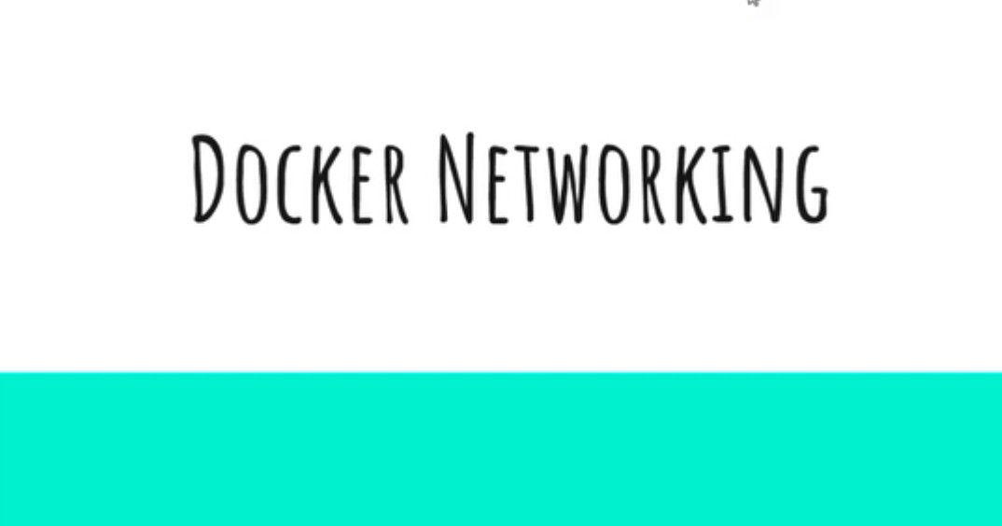
Docker - Network

Slide 41
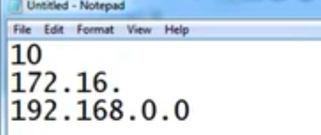
IP -
What is an IP address and why do we need IP address?
To uniquely identify the machine
What is the format of IP address? Is it a finite or infinite number?
It’s a finite number and it has the convention of X.X.X.X (where X – 0-255), we are having the devices twice the human population on earth and its not sufficient to use the IPv4 address, so that’s the reason why they has come up with IPv6.
The university has come up with the restrictions, below are the address used for private IP address.

Slide 42
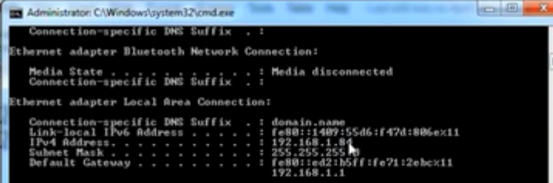
Continued..
What is my Ip address on the machine?
My IP address is “Ipconfig” 192.168.1.1 -> using this I will not be able to connect from external world.(this is private IP).
But still I am able to connect to the external world rite, how is that possible. We have wifi router, observe “Default Gateway” is northing but the IP address of the Router. Or device which takes you to the next network

Slide 43
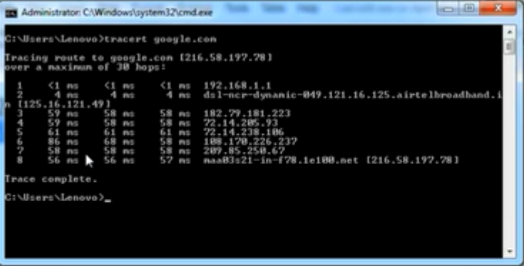
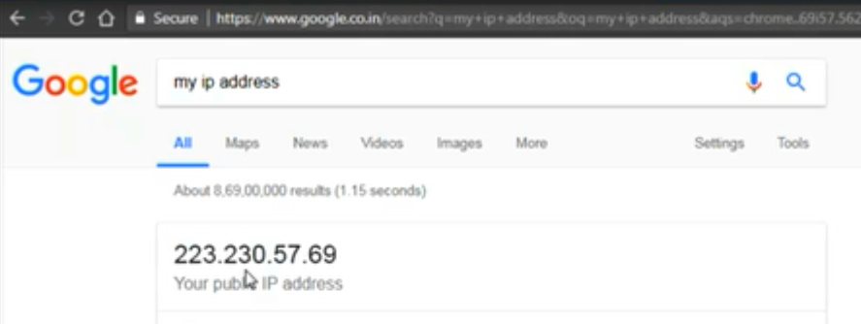
So, I have a router and it has a leased line of beam, my network goes into the beams network and from there it goes wherever I want, to see that, there is an interesting command – “tracert google.com”
So, we have typically 8 devices/networks it takes to connect to Google. This is called as hopping, you hop across different networks to reach the destination.
Search in Google – “my ip address” -> this is the public IP address of the beam/wifi router and not your device public Ip address.
Router – routing is a concept which takes our packet from one network to another. Normally our packet will not be able to travel into different network. I can travel in local network.

Slide 44
Why do you think internet has been designed? Or root cause of designing internet?
To connect to multiple networks.
This was invented by American military, let’s discuss about the use case:
Initially to our knowledge network is fixed, if you speak about telephone network it is fixed wire(one line from Hyderabad to Vijayawada – through which all the network data will be going).
There is one head quarters in US and they have different military camps, to which fixed lines are connected, if any of the camp has been blasted, the network will be down. So, they didn’t wanted this, even if one of the center is down, they wanted the network to continue, what they though is rather than having fixed network, they thought of having dynamic.
What happens in the internet, whenever you ask it route itself to the destination, every time the routing might not be through the same path. That’s how it has given birth to routing, hopping …etc, that’s how internet basically works.
That’s how things started working dynamic, but this has some troubles also, what hackers do, they safely connect to one location, they listen through all of the data and use their encrypting skills to basically get through. This is the loop hole in this methodology.
All of the communication in the internet was HTTP, http is plain text communication, so what they have done is they have built a cabling around it, where all of the data which is transmitted is encrypted, so Https is used to encrypt the data and sent, the person who wants will decrypt it and read it.

Slide 45
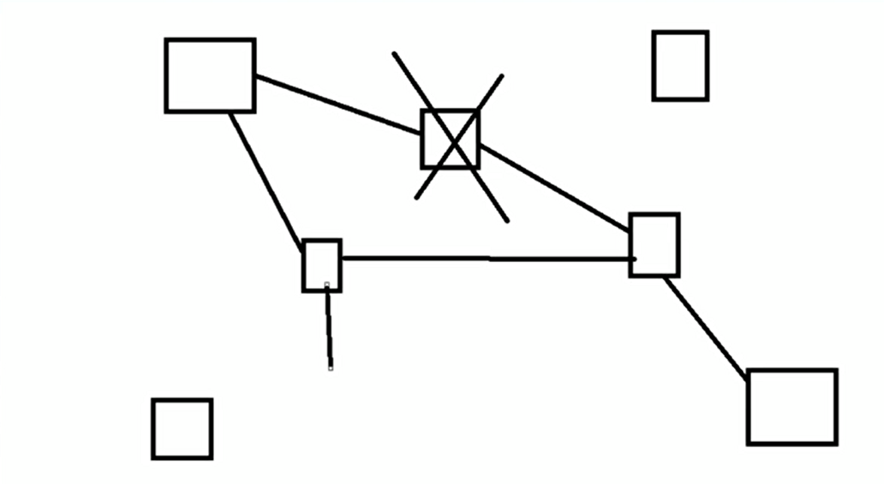
Example – head quarters and military camps

Slide 46
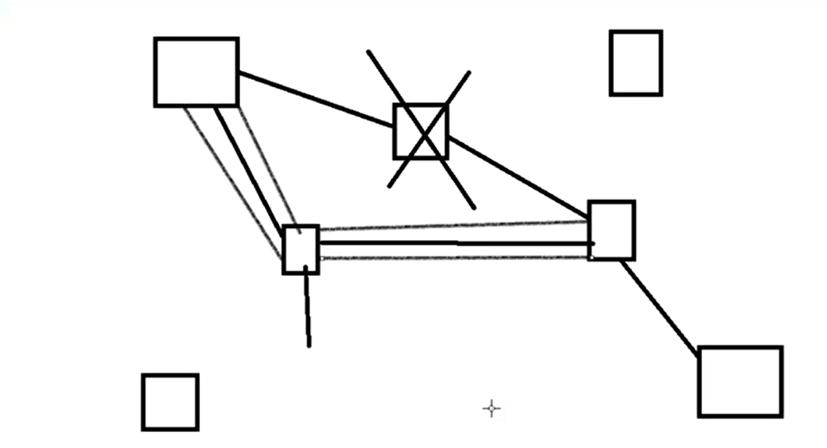
Https – Security - cabling
We call it as certificate security and key based security, on the wire this is what happens,

Slide 47
Let’s say I want 30 machines in the network, Here in the IP address we have 192.168.2.1(4 digits), each digit has 8 bits of data, and a bit can carry 0 & 1, so totally we can carry 2^8(256) and you cannot carry all 0.0.0.0 zeros, because it is used for default gateway’s and you cannot carry all 1’s, because that is used for broadcasting, so 2^8 – 2(254 devices which you can connect)
We were thinking the network as decimals, 192.168.0.10 - With in the network if you are creating another network, this concept is called sub netting/sub network. But the problem with this was you were unnecessarily wasting the IP address.
So what they had come up with some other binary scheming called as CIDR, what CIDR does is rather than thinking of IP address as a decimal number, it thinks as a binary number.

Slide 48
Continued.. This is subnetting, Network engineer team does this
X.X.X.X -> each digit is of 8 bits, each bit can be 0/1. it cannot have all 0’s or 1’s.
CIDR – Binary – 192.168.0.10 = 32 bits.
192.168.0.10/24 -> left with 8 bits, so 2^8 – 2 = 254, so this CIDR can connect with 254 devices.
192.168.0.10/28 -> left with 4 bits, so 2^4 – 2 = 14, so this network is capable of connecting to 14 devices.
10.0.0.0/8 -> left with 24 bits, so 2^24 – 2 = , so this network is capable of connecting to 14 devices.
Now, we can restrict your IP address to nearest possible numbers.

Slide 49
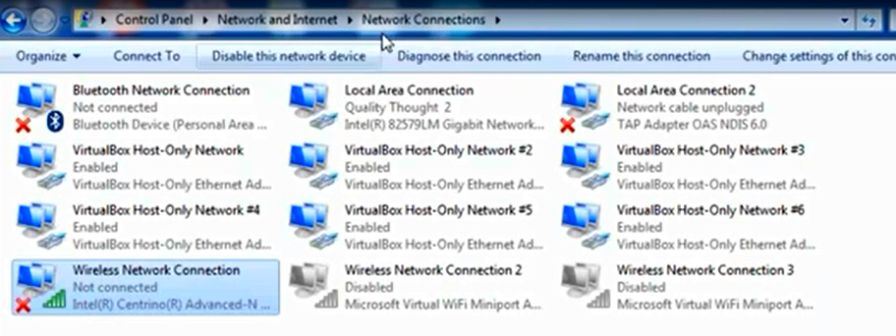
How will we get the IP address to VM/docker
In Windows we call this concept as NAT, and in Linux we call this concept as Bridge, which establish the communication between the host and containers.
Click on “Change adopter settings” under control panel - Actual adopters which are functional - “local Area Connection” and “Wireless Network Connection”(physical in nature). And when we install Virtual box, we get virtual adapters(these are called as soft adopters).
So Docker also creates some kind of soft adapters on the host machines, this soft adaptors tries to establish a communication (I have two containers in the same network and was able to ping them using their IP address), I was able to communicate from my machine to docker machine.

Slide 50
So by default whatever contianers that we create using the RUN command, all of them are launched by default bridge created by installation of docker called as “Docker Zero”

Slide 51
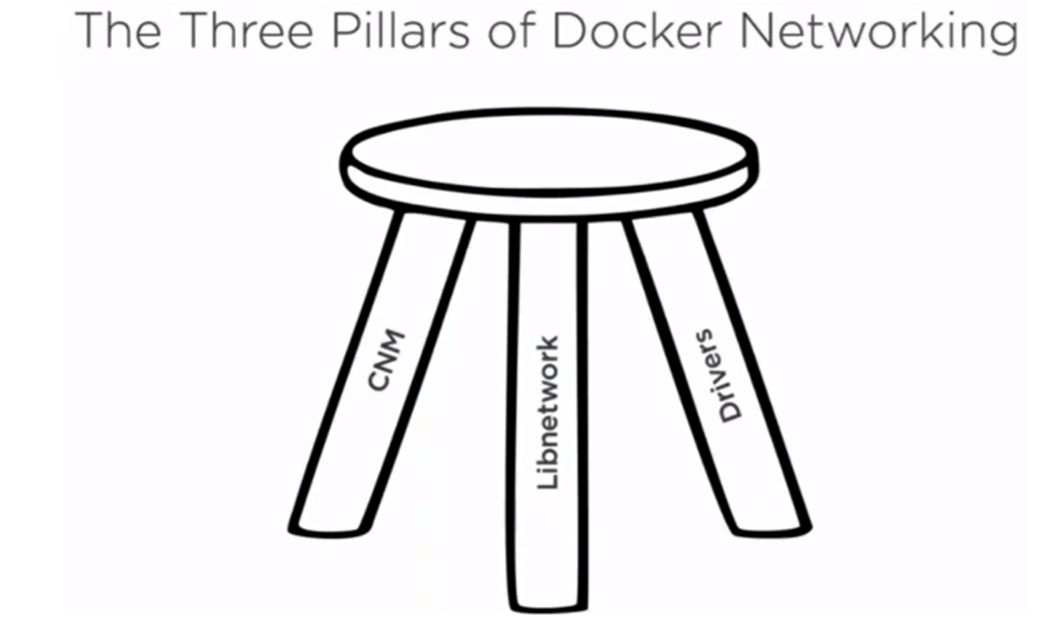
Docker Networking
Docker was heavily working on containerization aspect and networking was on least priority. Then they have acquired a company called “SoftPlay”, these were the guys who were working on the docker Networking before they got merged. After these guys joined Docker, networking became stronger, so from 1.12 docker Network is consistent now. Before that you docker network was part of Libcontainer/docker Engine. Now they have separated out and we have all together different code base for networking which we call it as “LibNetworking”
Vmware was also not good in networking, after acquiring EAS come in, networking has become rich.

Slide 52
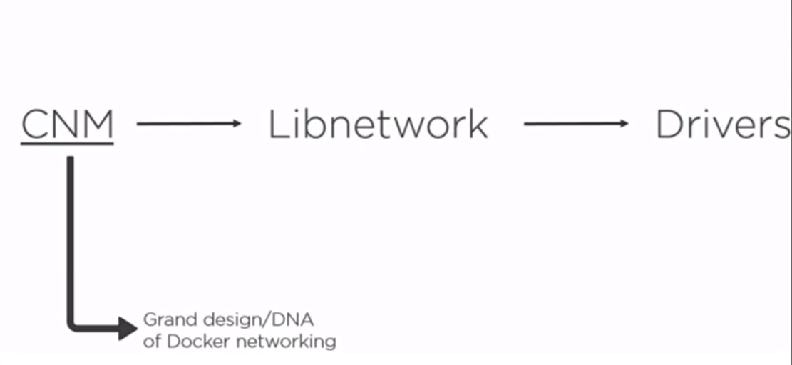
Let us try to understand each one of them
CNM(Container Network Model) – is a kind of requirements document/not software. This is where all of the network specifications are designed(basically this tells what has to be done – This is been created/proposed by Docker Inc).
It is present in GIT hub and we all can read through it(it specifies what Docker networking has to do)
Libnetwork: Northing but implementation of CNM.(e.g. an application created out of CNM document)
Drivers: This is specific to Networking detail(e.g what is the network which I want to connect to – is it between host and container (or) container to container (or) containers present in different networks). If you talk about networks – we have single host and multi host networks, the driver for single host and multi host cannot be same. So these guys had developed independent drivers for this( like windows has NAT and Linux has Bridge), all these has developed in a language called GO.

Slide 53
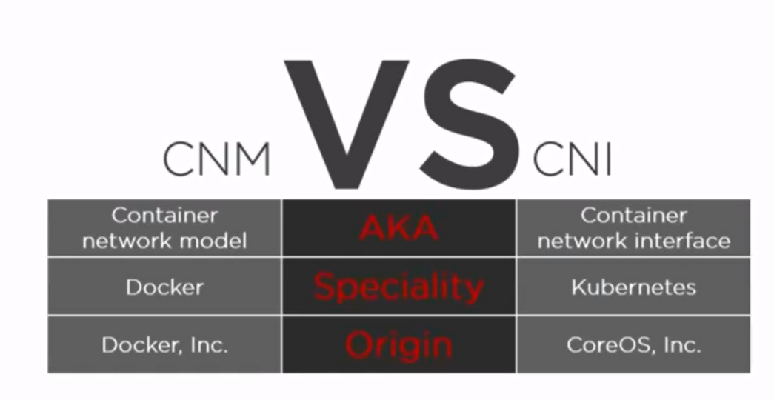
CNM VS CNI
CNM has competition in the form of CNI(Container Network Interface) document.
Docker Swarm primarily relies on CNM.
Kubernetes relies on CNI. It has different terminologies here, because requirement/specification document is different.

Slide 54
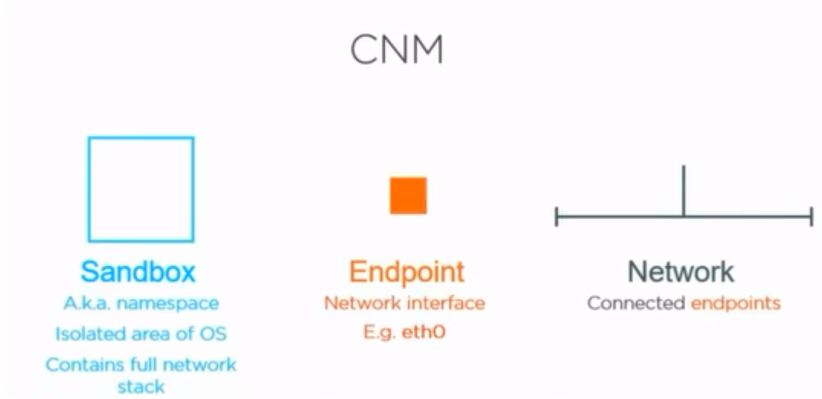
These are the three major things in CNM.
Endpoint – is northing but the adaptor which we have seen “Local Area Network”, in linux we have eth0 and eth1.
Sandbox: TO its core, it is northing but a network namespace. This area contains full stack implementation of network and it has isolated stuff.
Namespace is something which enables docker to be lean, In windows we don’t have namespace or equalent concept of namespace, like in linux we have namespace. So to keep common name to both environments, we call it as a Sandbox.
Network – this is something which we want to create or you can call it as connected endpoints.
All of your container network models will be around it – sandbox, endpoints and networks

Slide 55
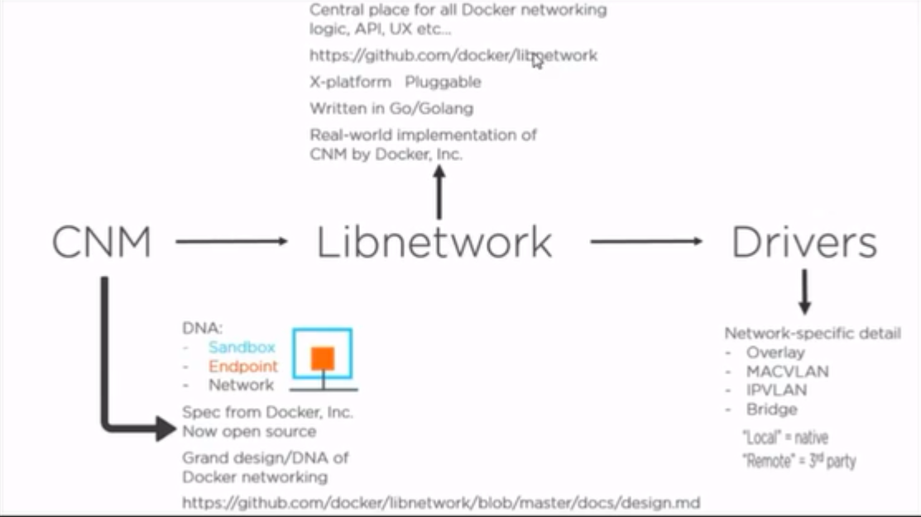

Slide 56
Continued..
Your machine becomes a sandbox – where your driver is plugged into, and we would be connecting to networks.
Libnetworks – implementation of all of CNM.
Drivers – (which does specific networking) - Are networking specific details, you cannot have same network driver every where or you cannot give a network driver which works every where. That’s why we have different networking drivers

Slide 57
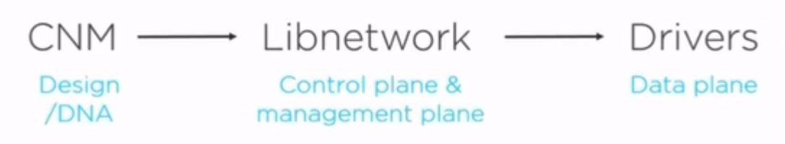
Network is what we need to create
For example, if we want to create a single host networking between my containers, then we would be using what is the driver which you need to use. So to establish the network, what is the driver you would be using/ what is the network which you want and what is the endpoints which it creates.
We would see different types of networks available.
How to create single host network and multi host network.

Slide 58
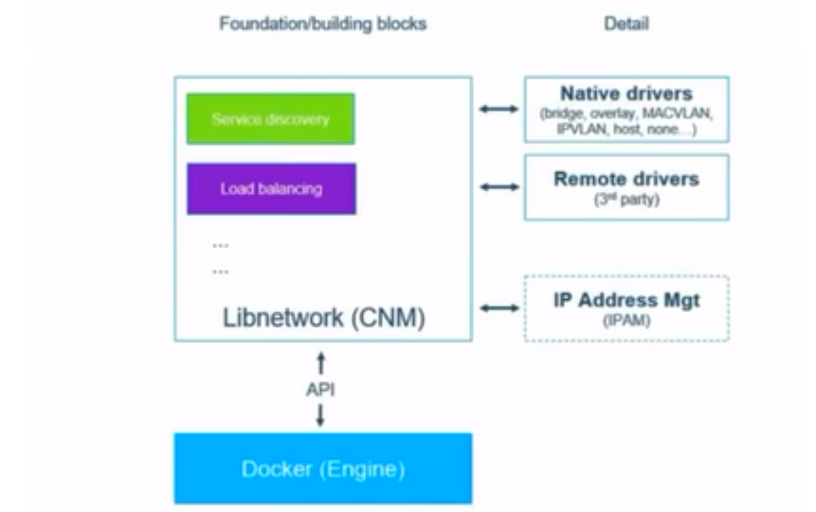
When we combine everything the architecture looks like this

Slide 59
Initially, network was part of docker engine. After the Softplay guys came in, they removed the network out of the docker engine and they have created another components.
Service discovery : - Which is Name based resolution.

Slide 60
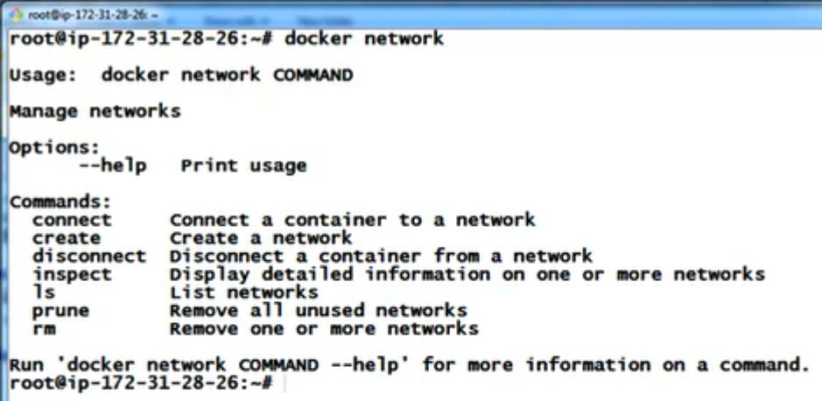
Network in Docker – Invoke using command

Slide 61
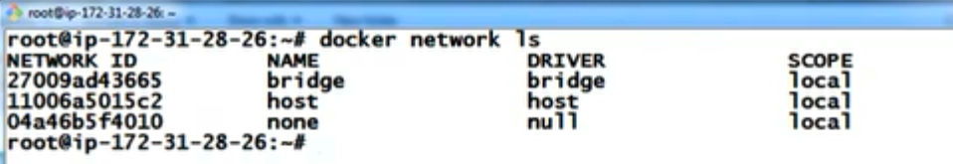
To get the list of networks in docker
“docker network ls” – these all are the networks available.
Bridge is the default network, when we use the command #docker run –it ubuntu /bin/bash -> this will use the bridge driver.
Scope – Local – single host network.
Multi – multi host networking, you might not see the scope as multi, you might see it as swarm. You will be able to connect to two docker engines, which are running on different machines.
Multi host networks are created natively using swarm. Swarm is by default a cluster creation in docker.
None – means no network – it would launch the container and would not be connected to anything, and it would be running. No usecase
Host – You would be able to communicate from your machine to that container and that container would not be able to connect to any other container. It would be just connected to your machine.

Slide 62
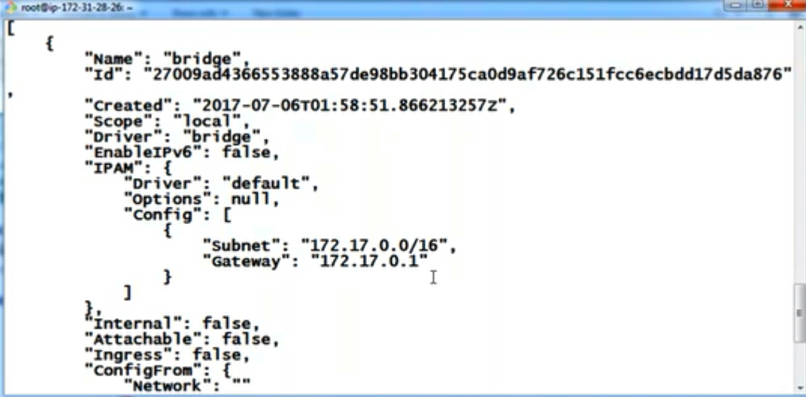
Let us inspect the bridge driver
Command to inspect –
Name of the bridge and driver name are same, we can change the name of the bridge, but not the driver name.
#docker network inspect bridge
The gateway of default driver is 172.17.0.1,this is like router to this network. And in this network we can connect to (2^16 -2) devices, we can launch these many containers, if you really have that much computing power.

Slide 63
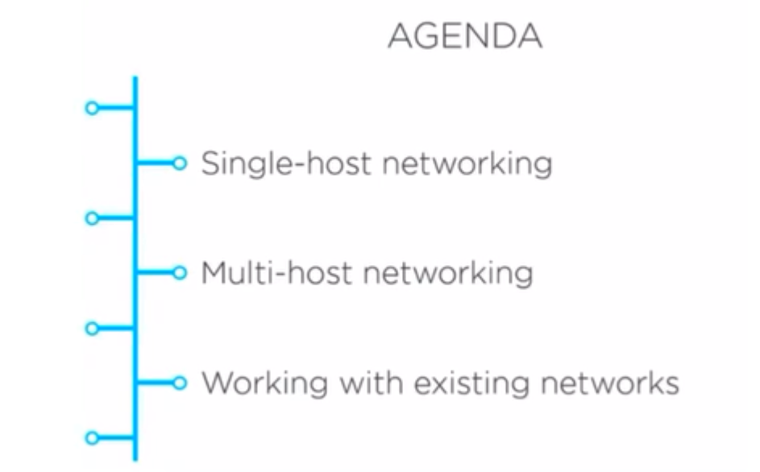
Agenda -

Slide 64
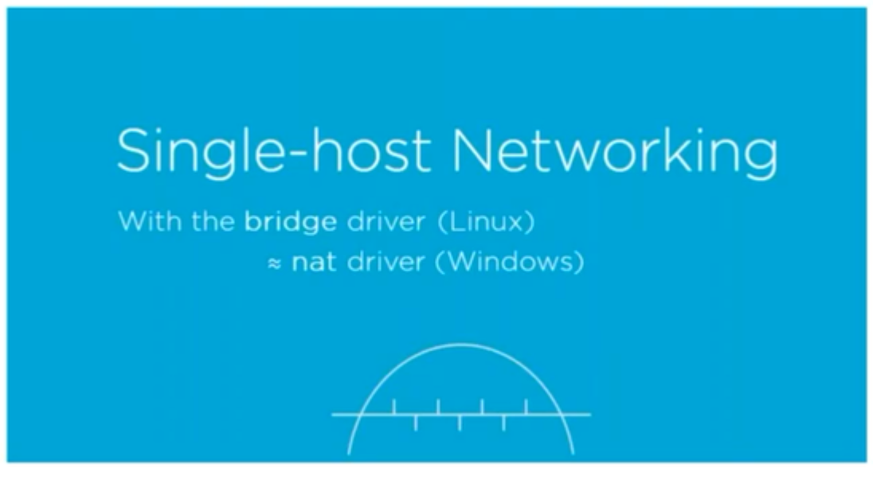

Slide 65
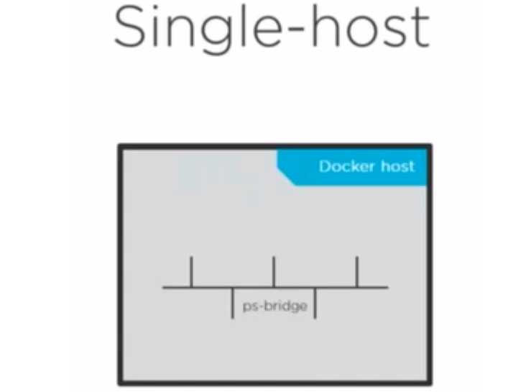

Slide 66
Single-Host
Single host – basically we would create a network in your machine and you can launch multiple containers.
In the same machine, if you had created two bridges(if you don’t want the default bridge been used, and wanted your network to be used, we can create our own driver, on the same machine), bridge1 and bridge2, you will not be able to communicate with each other. So, all of the communication happens between the containers in the same network.
If you want to create multiple containers in your machine and establish network connection between them, then we would be using a bridge networking.
In case of windows you would be using a NAT driver.
Note: scope of any local network is its implementation/driver.

Slide 67
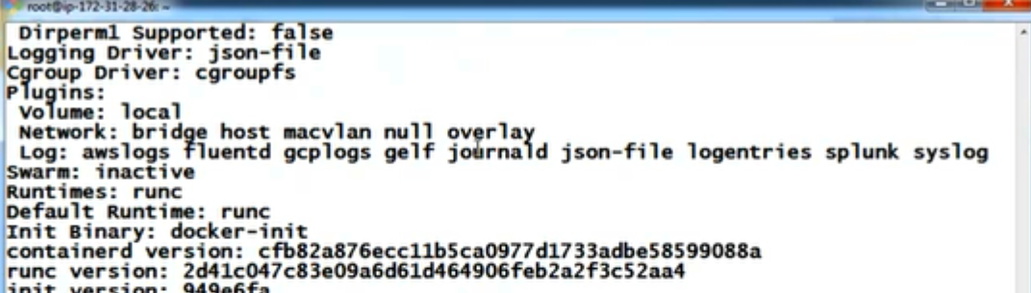
To know the list of network drivers available in the machine
#docker info -> will show you the drivers available in the machine. Observe – Network section for the same.
We can also use the third party drivers, for that we need to install first to use them

Slide 68
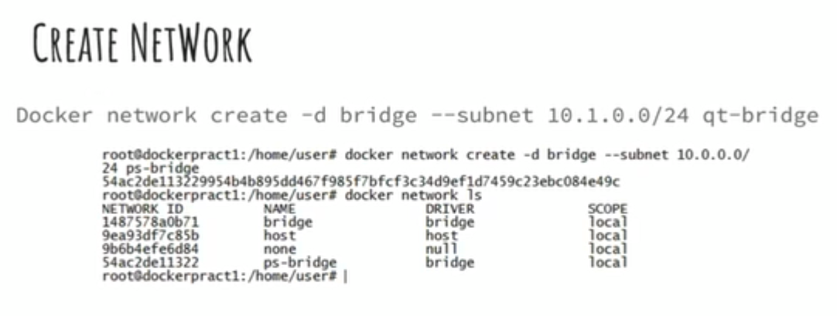
Create Network
Let’s create our own bridge, called as ‘ps-bridge’
If you want to create a new container in different network driver, you need to mention –d and its name.
If I don’t specify the network, it will launch in bridge network,
Inspect the network using -#docker inspect network ps-bridge

Slide 69
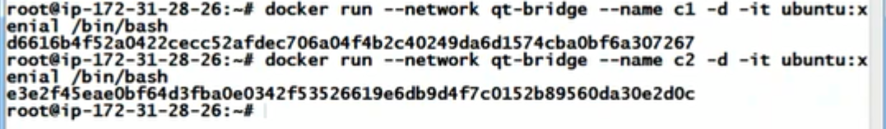
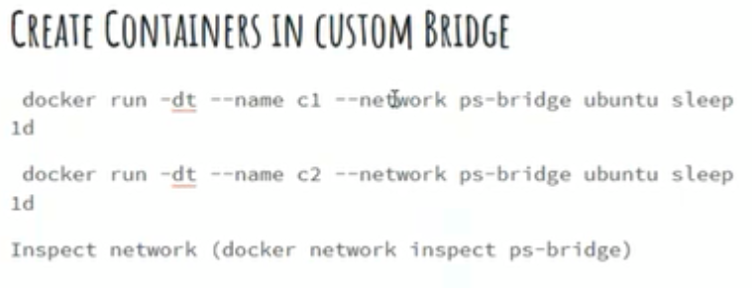
How to create a container in a specified network.
If I don’t specify the network, it will launch in bridge network,
Below command will create a container and would sleep for one day, and will not do any activity.

Slide 70
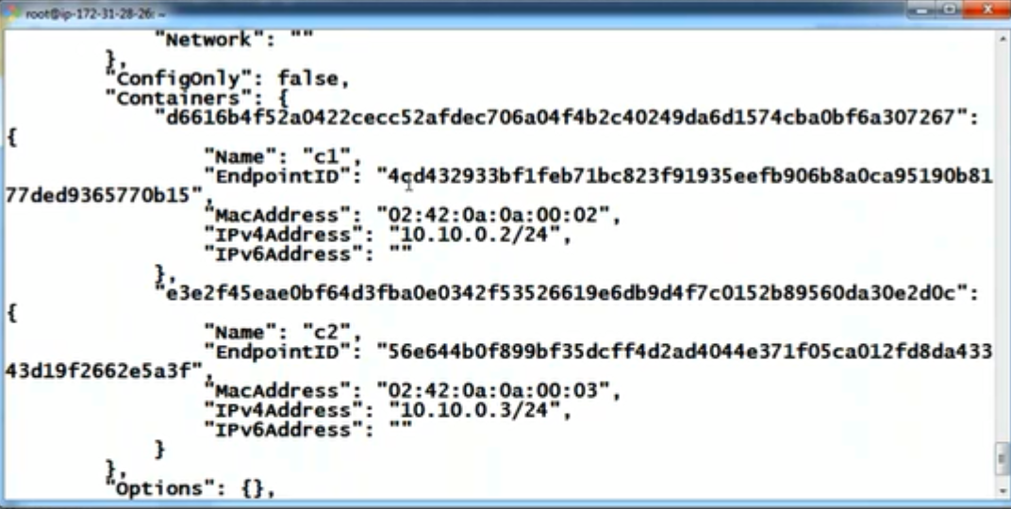
Now, lets inspect the network
#docker inspect network ps-bridge

Slide 71
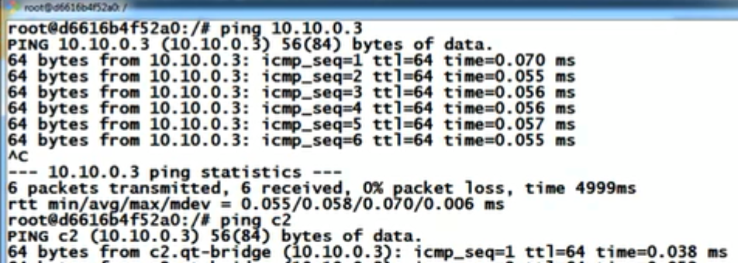
Continued..
Get into the container and do
#apt-get update
#apt-get install iputils-ping -> to ping the machine
#ping 10.10.0.3/c2 -> c2 IP address
Domain name resolution(DNS – called as Service discovery) for the default bridge is not been enabled, where as domain name resolution will be enabled by default for the custom network created.

Slide 72
Now, I want to host an application and access it from the external world.
We can use port forwarding to host machine . -> under bridge network we have to do this for accessing the application. This is the only way.
Multi-host Network– Two Docker engines on two different machines, and how the networking will be established. I want to have one container in one machine and need to talk to another container in different machine. This cannot be done using bridge network. This is called as multi-host network.

Slide 73
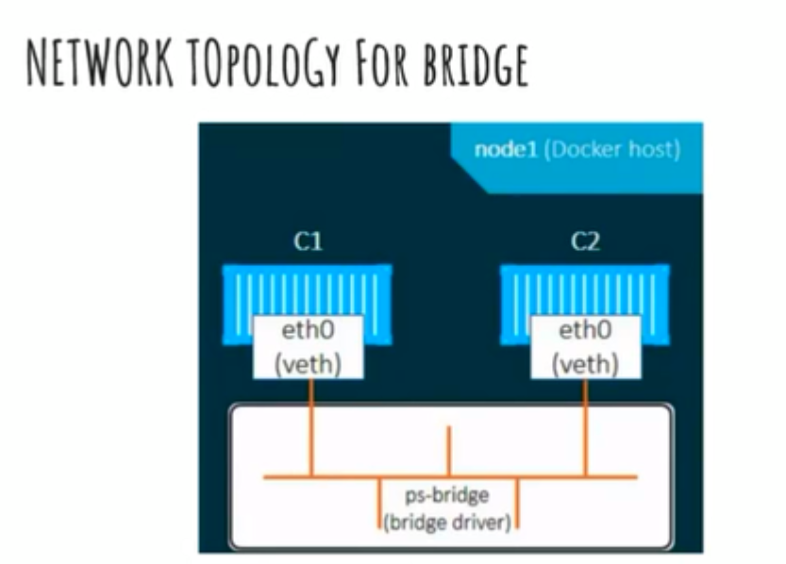

Slide 74
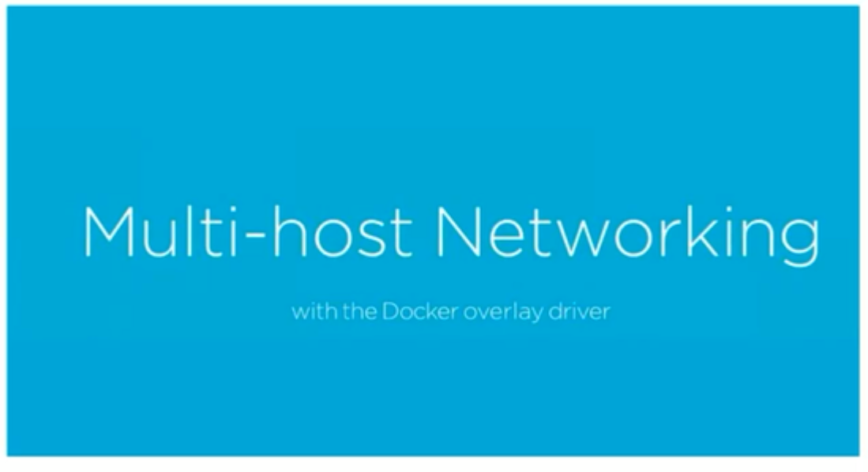

Slide 75
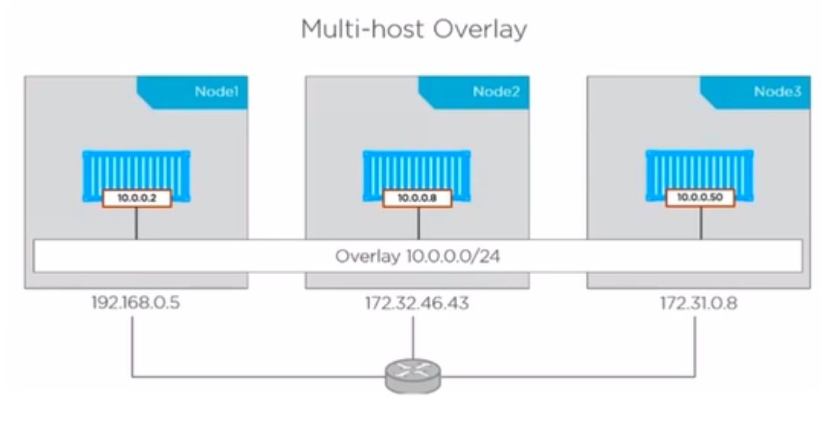

Slide 76
Three containers running on three different machines will not be under same network.
Here to have all of them connected, bridge network cannot help in this regard, so we have overlay networking – to get this achieved.
So, swarm internally uses something called overlay networking.
First requirement is –
All of the machines should be pingable to each other. IF there are not been pingable, then multi-host is not achievable.
Two nodes should have docker engines and can be different operating systems also.
In this example node1 is reachable to node2 and node3.
Two bridges cannot communicate without swarm.

Slide 77
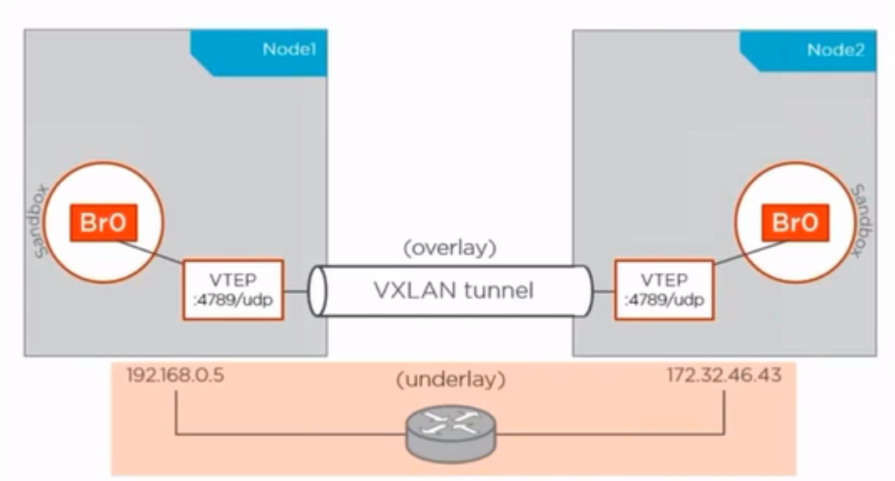
Once the underlay network is established, It created overlay network which looks as if they are connected.
Underlay means physical connection between these two machines.
Overlay network looks like below.
VXLAN tunnel – a tunneling connection created between two machines. Logically it looks like packet is moving via VXLAN tunnel, actually it is going via underlay. And for the tunnel, we have endpoint/adaptor created on the machine, and this will be connected to the sandbox. Then, we would be having the containers running on the basic network.

Slide 78
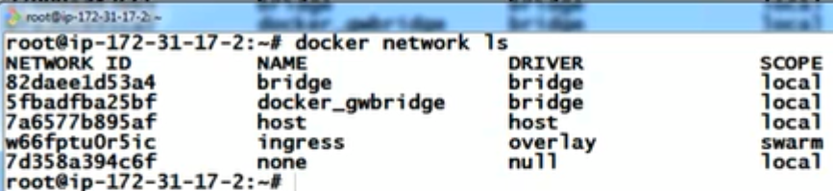
Lab – Launch two AWS Ubuntu instances
Step01 – Connect to the AWS instance.
Step02 - #apt-get update
Step03 – google “install docker ubuntu” - select – docs.dockers - https://docs.docker.com/install/linux/docker-ce/ubuntu/#install-using-the-repository
Step04 – Enable rule “All ICMP – IPV4 - Anywhere” to allow the pings.
Step05 – Ping the machine by its private IP address.
Step06 – Login to one machine and do
#docker swarm init (this machine is called “Manager”)
Swarm is an answer in docker for multi-host networking and clusterring.
Step07 – Join other machine using join command given by swarm init(this machine is called “worker”) before that open the ports specified in next slide, for both the nodes.(Note: you need not open any ports, because all of the ports are already open)
Step08 – Now, check both the machines for the overlay network.
#docker network ls

Slide 79
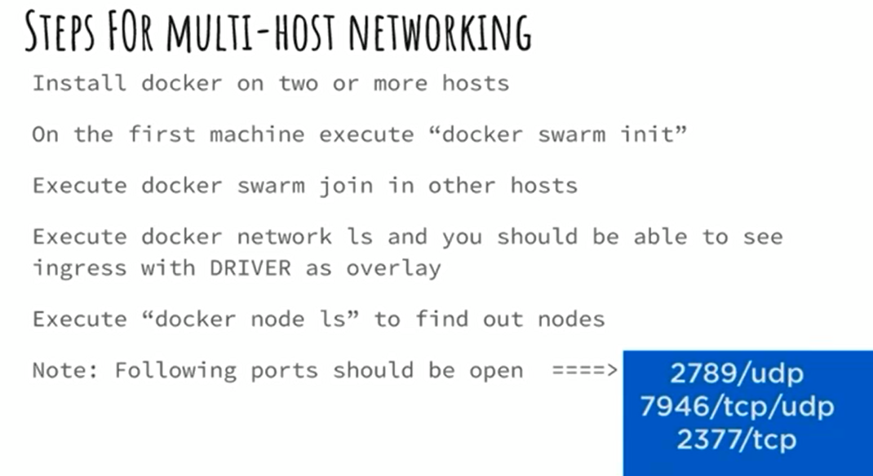

Slide 80
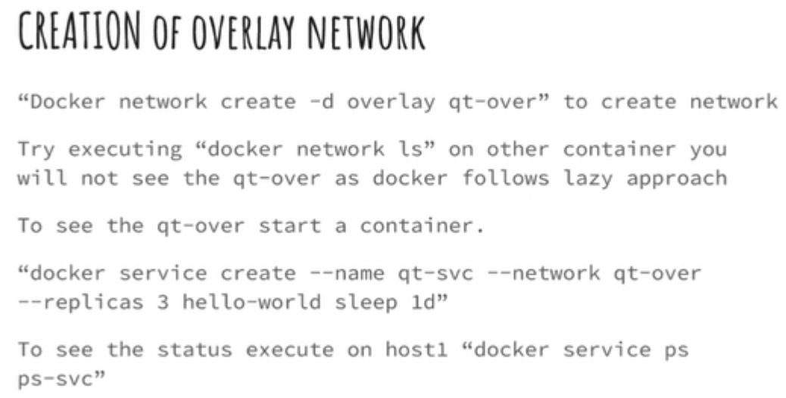
Now, how to launch the containers in these networks…before that create the networks and then launch them
Normally, we would create a container using “docker run –it ubuntu /bin/bash” and would be relying on the container, But, when we go for clustering, we would rely on service. There would be url associated to the qt-svc and users would be using it. Because you never know where the container is.

Slide 84
Docker file to setup a mongodb
FROM ubuntu
MAINTAINER karthik “karthik@gamil.com”
RUN apt-get update
RUN apt-get install –y gnupg2
#add the package key verification
RUN apt-key adv --keyserver hkp://keyserver.ubuntu.com:80 --recv 9DA31620334BD75D9DCB49F368818C72E52529D4
#add MongoDb to the repository source list
RUN echo "deb [ arch=amd64 ] https://repo.mongodb.org/apt/ubuntu trusty/mongodb-org/4.0 multiverse" | sudo tee /etc/apt/sources.list.d/mongodb-org-4.0.list
#Update the source list
RUN apt-get update
#Install MongoDb package
RUN apt-get install –y mongodb-org
#create default data directory
RUN mkdir –p /data/db
##################Installation End##############
EXPOSE 27017
#commands to get executed at the entry point
CMD [“/usr/bin/mongodb”, “—config” , “/etc/mongodb.conf”]
Notes:
Installation - https://docs.mongodb.com/manual/tutorial/install-mongodb-on-ubuntu/
Remove sudo
Change double quotes to single quotes

Slide 85
Docker compose
Run all the three containers in a single docker command – is called docker compose. Using YAML(docker-compose.yml) file.
Docker-compose.yml
wordpress: ->container
image:wordpress ->image
links: -> linked to db
-wordpress_db:mysql
ports: ->exposed host port 8080 for container port 80
8080:80
Wordpress_db:
image:mariadb
environment:
MYSQL_ROOT_PASSWORD:test
Notes:
https://www.edureka.co/blog/docker-compose-containerizing-mean-stack-application/

Slide 86
Docker swarm

